Slide 1

Kickstarter Projects predicting Success and Failure
Shikshya Adhikari
Springboard Capstone

Slide 2


Business Problem How can the company Kickstarter increase the success rate of its projects over the next year by spending resources on projects with the higher likelihood of success?

Slide 3

Possible Solutions Focus on increasing the pledged amount for its projects. Better advertising of the projects irrespective of country or category will be helpful.

Slide 4





Importance of the Business problem
Image credit: https://logos-world.net/kickstarter-logo/; https://seeklogo.com/vector-logo/306543/indiegogo https://www.investopedia.com/best-crowdfunding-platforms-5079933

Slide 5
Data
https://www.kaggle.com/kemical/kickstarter-projects
https://www.kaggle.com/yashkantharia/kickstarter-campaigns

Slide 6
Data Wrangling
Years 2009-2019
500,000 rows after combining
Step 1: Exploring and Combining the dataset
Remove duplicated observations
Dropped columns – no analytical importance
Extracted values
Imputed/removed null values
Step 2: Cleaning the dataset

Slide 7
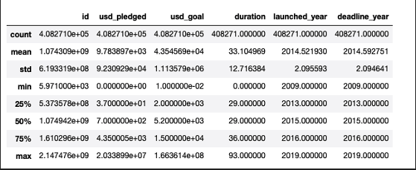
Descriptive Statistics Numerical columns

Slide 8
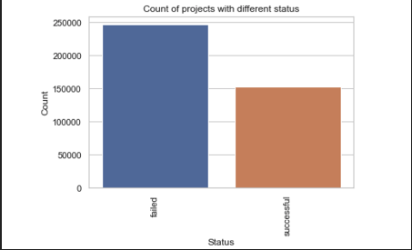
Exploratory Data Analysis
Target Variable: Status of the Project

Slide 9
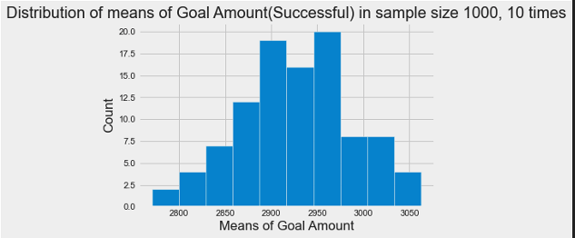
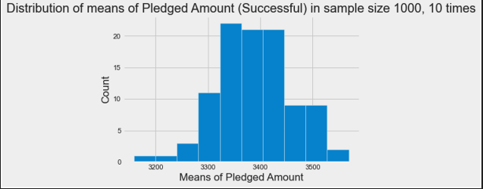
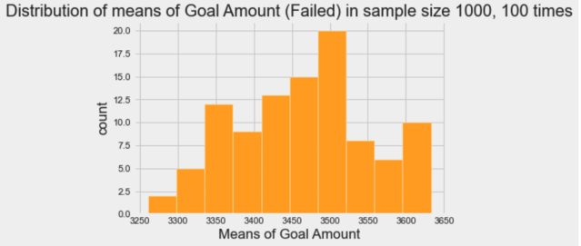
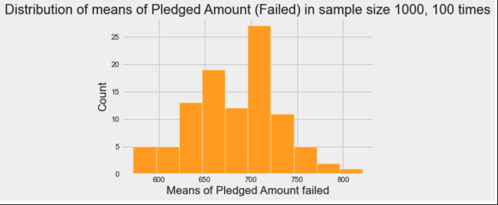
Feature 1: Goal Amount
Feature 2: Pledged Amount

Slide 10
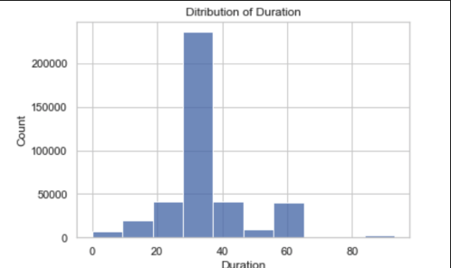
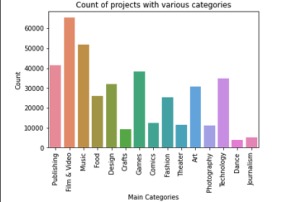
Feature 3: Duration
Feature 4: Main Category

Slide 11
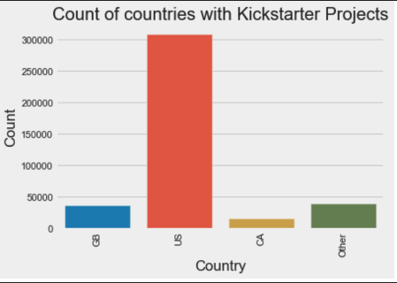
Feature 5: Country
Some countries in this category are ‘masked’ in the ‘Other’ category
Did not have enough observations to be of analytical importance

Slide 12

Relationship Between Variables

Slide 13
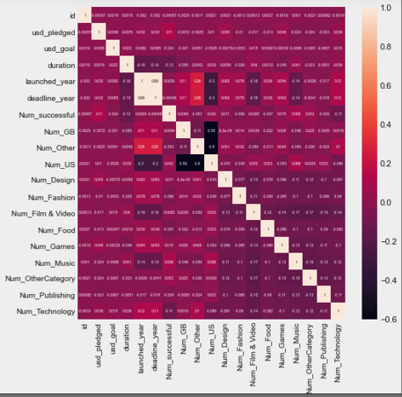
- IVs of interest – not very correlated
- Possible correlation between:
Status and Pledged Amount
Status and Country
- Status not correlated with duration
- Weak correlation between Status and Goal Amount

Slide 14
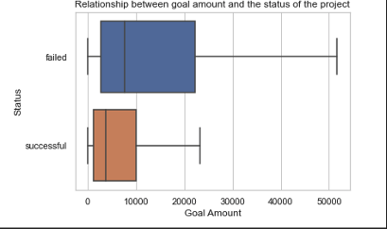
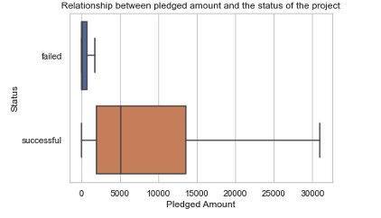
Relationship 1: Goal Amount and Status
Relationship 2: Pledged Amount and Status
Higher goal amount – higher chances of failed projects
Higher pledged amount – higher chances of successful projects

Slide 15
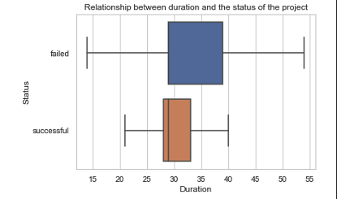
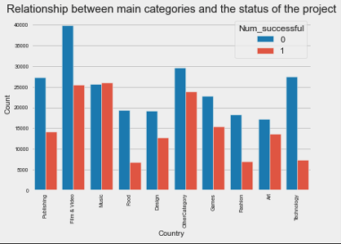
Relationship 3: Duration and Status
Relationship 4: Main Categories and Status
Duration and Status not correlated
Main Category – not the best indicator of success or failure

Slide 16
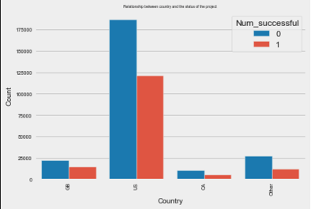
Relationship 5: Duration and Status
Countries may not determine the Status

Slide 17
Hypothesis Testing
H_{0 :} There is no relationship between Status and the different IVs
Goal Amount
t -statistic | p-value
52.95 | 0.0
can reject the null hypothesis
Pledged Amount
t -statistic | p-value
317.76 | 0.0
Duration
t -statistic | p-value
317.76 | 0.0
cannot reject the null hypothesis

Slide 18
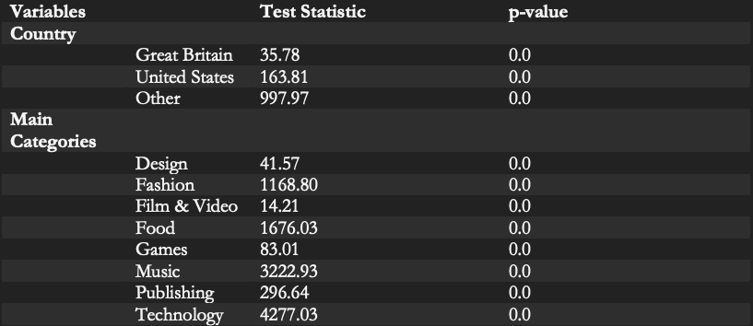
Hypothesis Testing
Country and Main Categories
Can reject the null hypothesis

Slide 19
Data Splitting and Standardizing
Define X and Y, splitting the data into train and test set
Scaling the Numerical Variables, Goal amount, pledged amount, Duration after splitting

Slide 20
Modeling Strategies Status (DV) is categorical
Reduces overfitting in single decision trees
- Quick prediction
- Employs techniques to reduce
variance
Random Forest Classifier
Efficient training
Coefficient size and direction of
association
Logistic Regression

Slide 21
Model Metric
Model | Accuracy (before HP tuning) | Accuracy (after HP tuning) | F1 (before HP tuning) | F1(after HP tuning) | Mean CV score
Random Forest Classifier | 0.97 | 0.97 | 0.97 | 0.97 | 0.97
Logistic Regression | 0.90 | 0.98 | 0.90 | 0.98 | 0.90
Logistic Regression did better after hyperparameter tuning.

Slide 22
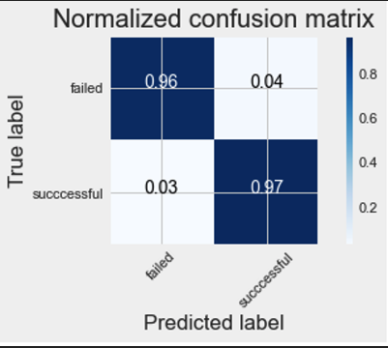
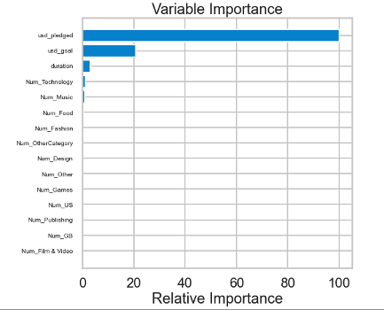
Random Forest Classifier

Slide 23
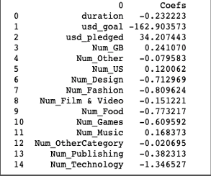
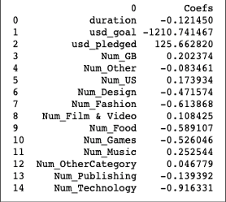
Logistic Regression
Coefficient Table (before HP tuning)
Coefficient Table (after HP tuning)

Slide 24
Conclusion
Random Forest : Pledged amount – Most important variable
Logistic Regression: Pledged Amount – Highest Positive Factor
Models show:
the pledged amount is the most important predictor of the success and failure

